Slide 1
PRESENTATION OF THE RESULTS OF THE KMS CASE STUDY ANALYSIS
BY
ADESINA MARIAM ADEPEJU

Slide 2
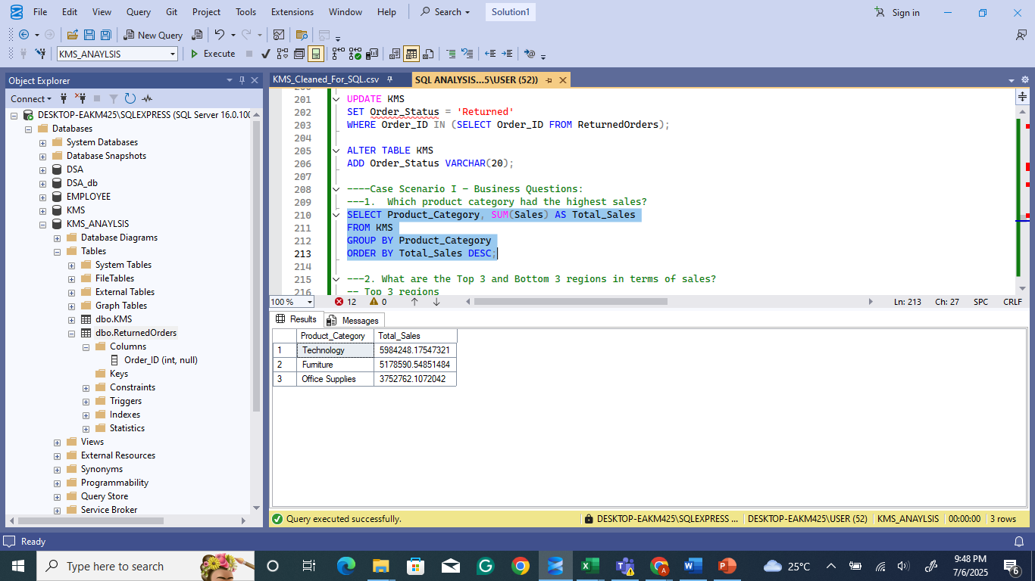
NO.1 WHICH PRODUCT CATEGORY HAD THE HIGHEST SALES?

Slide 3
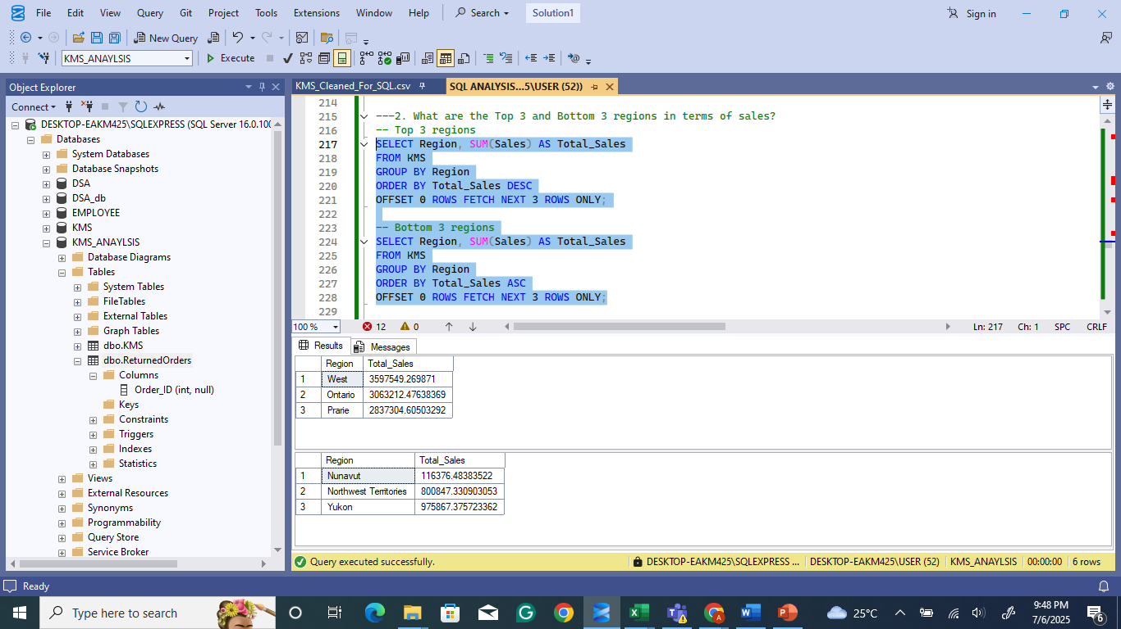
NO 2. WHAT ARE THE TOP 3 AND BOTTOM 3 REGIONS IN TERMS OF SALES?

Slide 4
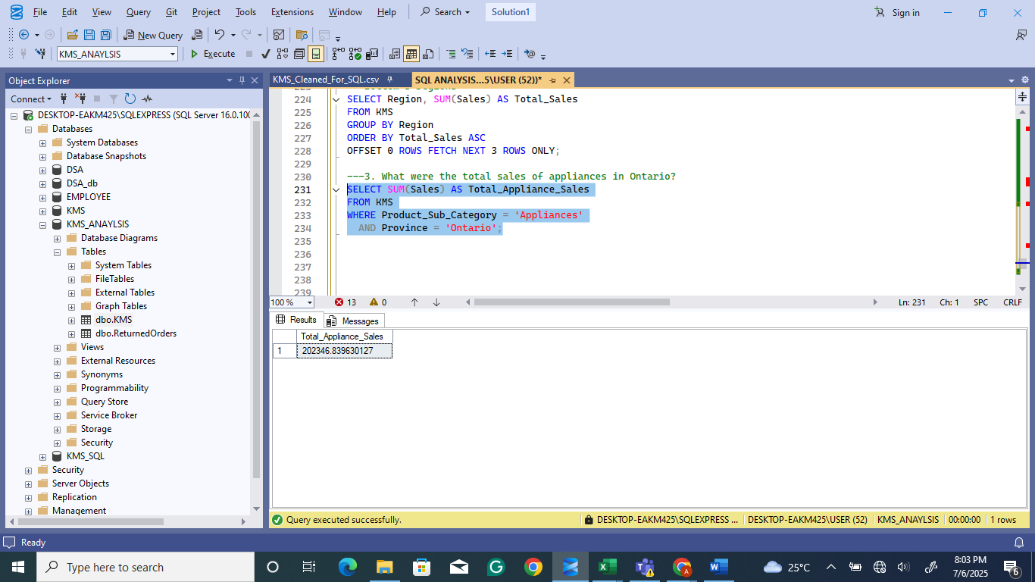
NO 3 : WHAT WERE THE TOTAL SALES OF APPLIANCES IN ONTARIO?

Slide 5
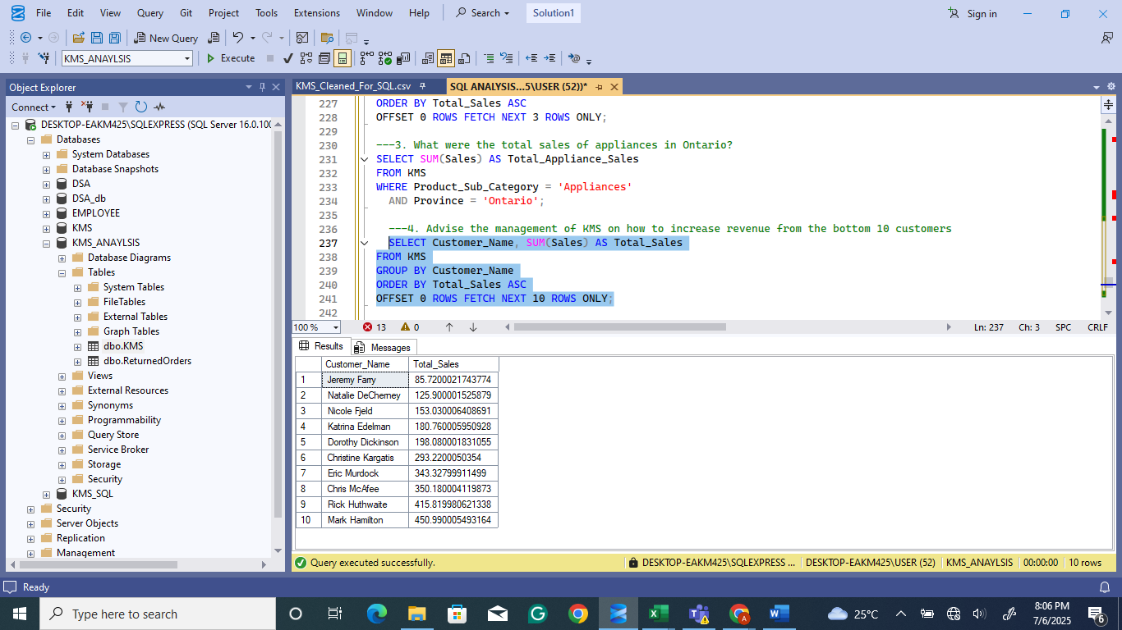
4 . ADVISE THE MANAGEMENT OF KMS ON HOW TO INCREASE REVENUE FROM THE BOTTOM 10 CUSTOMERS

Slide 6
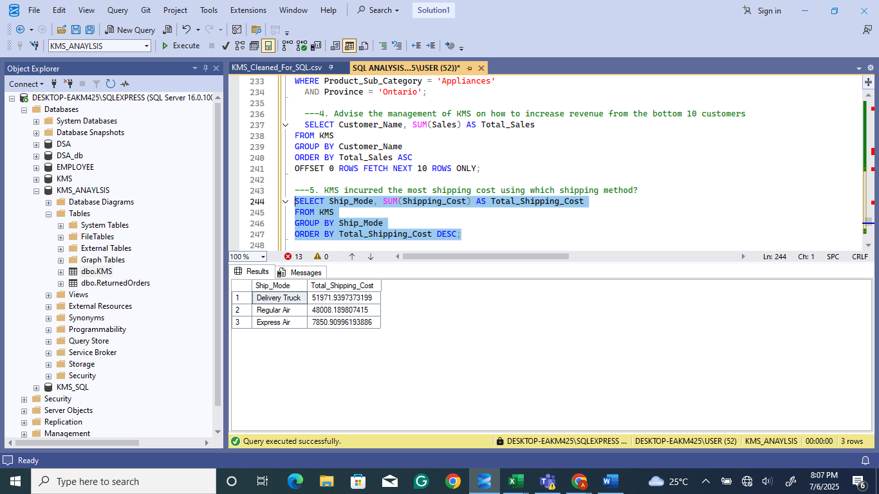
5. KMS INCURRED THE MOST SHIPPING COST USING WHICH SHIPPING METHOD?

Slide 7
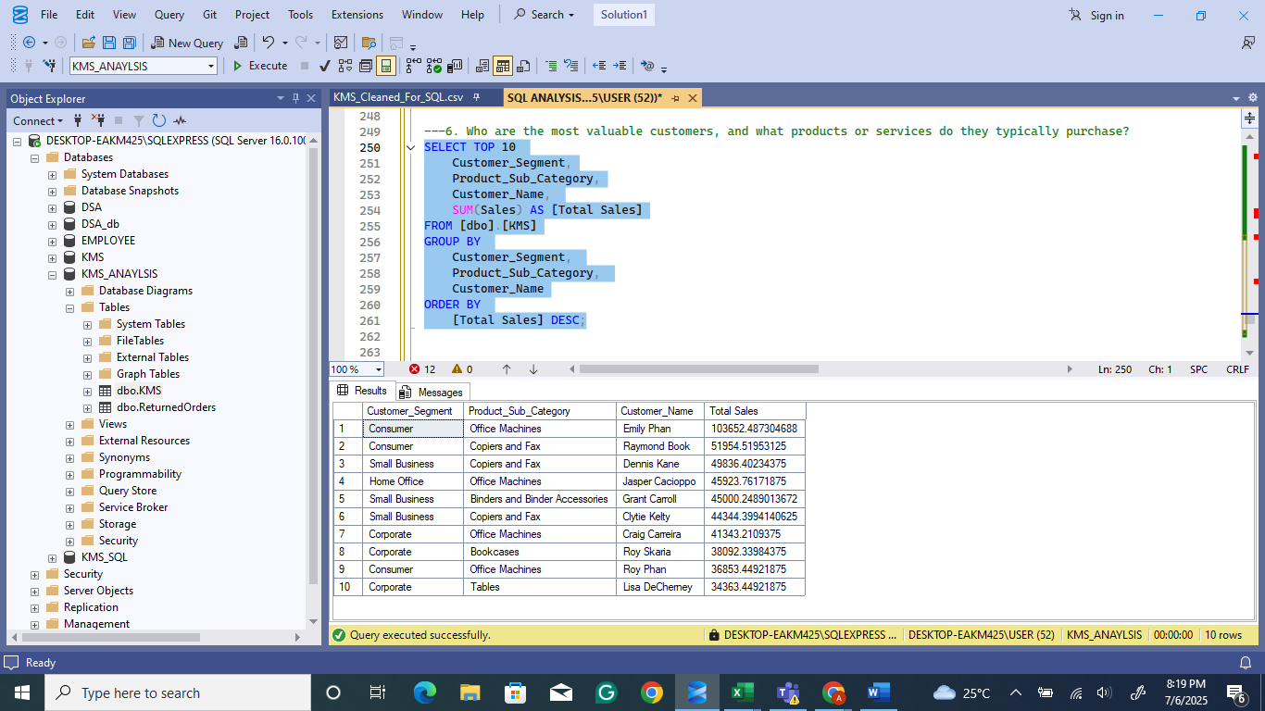
NO. 6 WHO ARE THE MOST VALUABLE CUSTOMERS, AND WHAT PRODUCTS OR SERVICES DO THEY TYPICALLY PURCHASE?

Slide 8
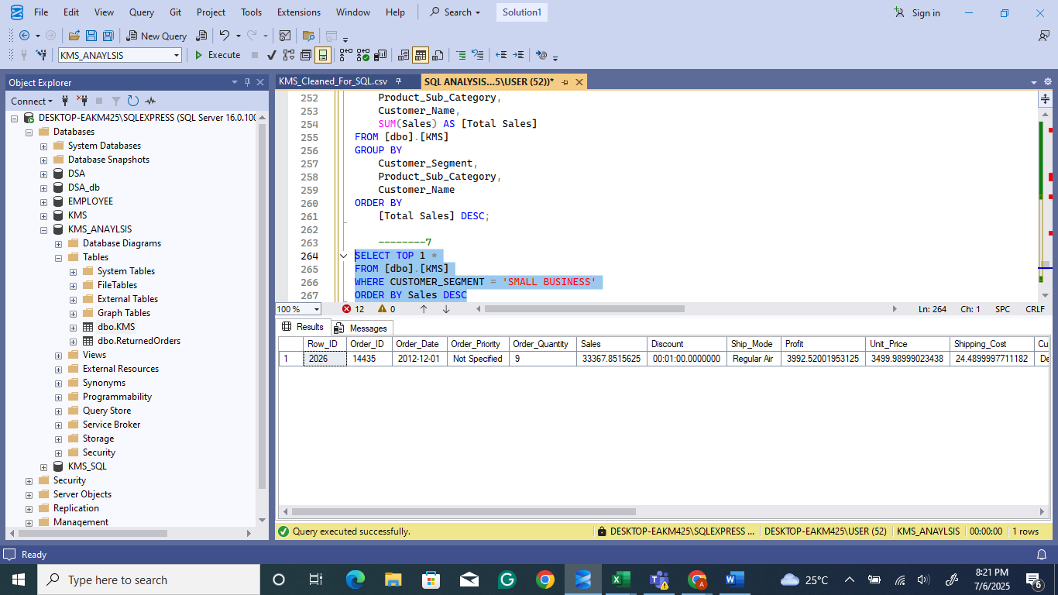
NO 7. WHICH SMALL BUSINESS CUSTOMER HAD THE HIGHEST SALES?

Slide 9
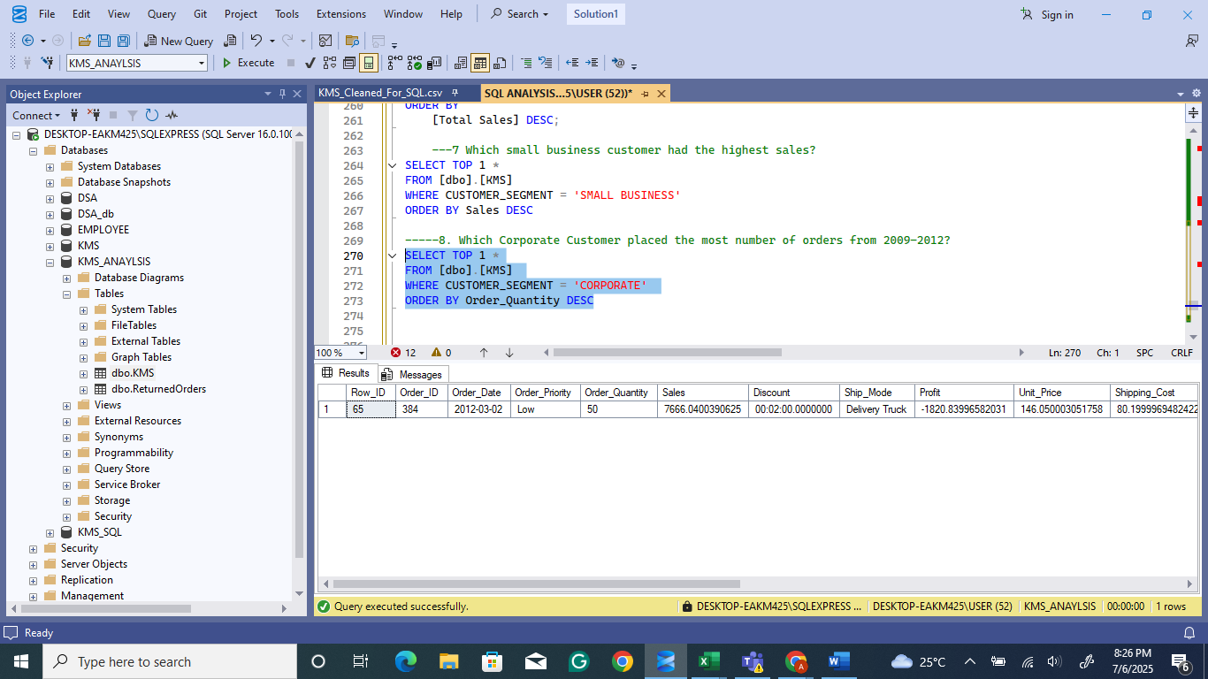
NO. 8 WHICH CORPORATE CUSTOMER PLACED THE MOST NUMBER OF ORDERS FROM 2009–2012?

Slide 10
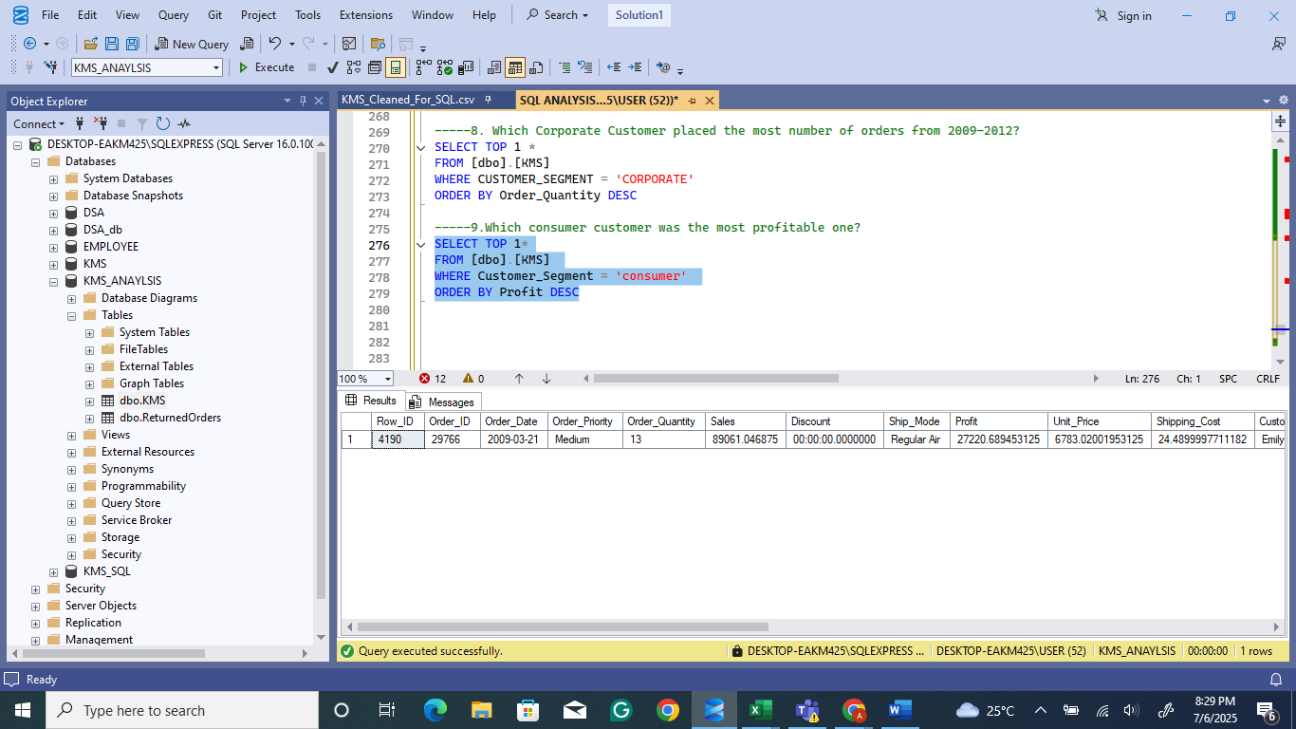
NO. 9 WHICH CONSUMER CUSTOMER WAS THE MOST PROFITABLE ONE?

Slide 11
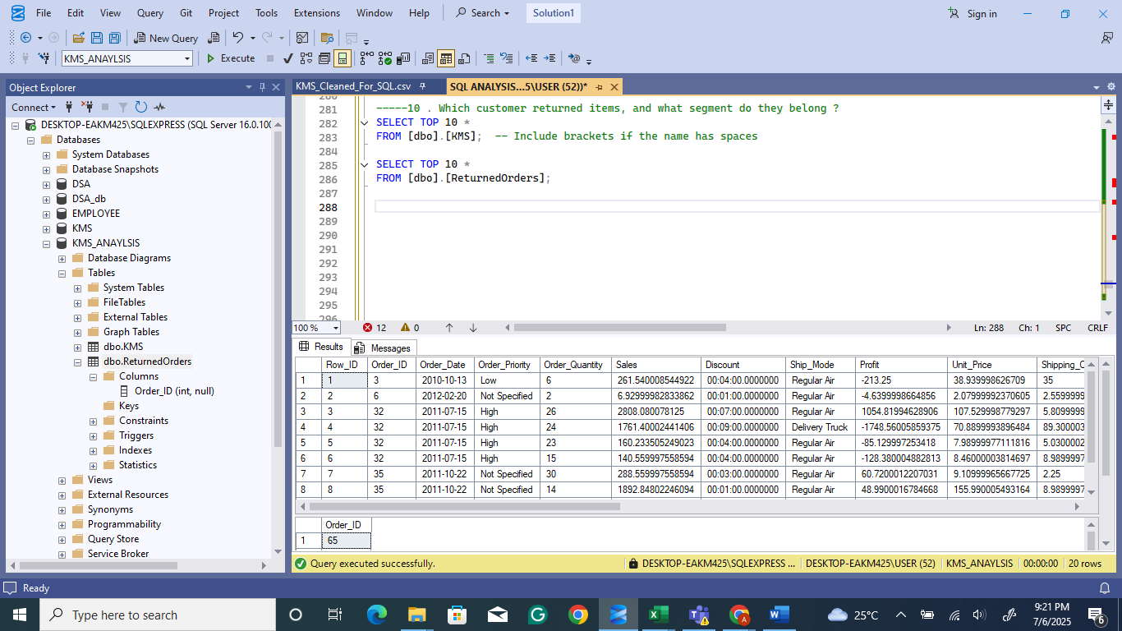
NO.10 WHICH CUSTOMER RETURNED ITEMS, AND WHAT SEGMENT DO THEY BELONG TO?

Slide 12

NO.10 WHICH CUSTOMER RETURNED ITEMS, AND WHAT SEGMENT DO THEY BELONG TO CONTD ?

Slide 13
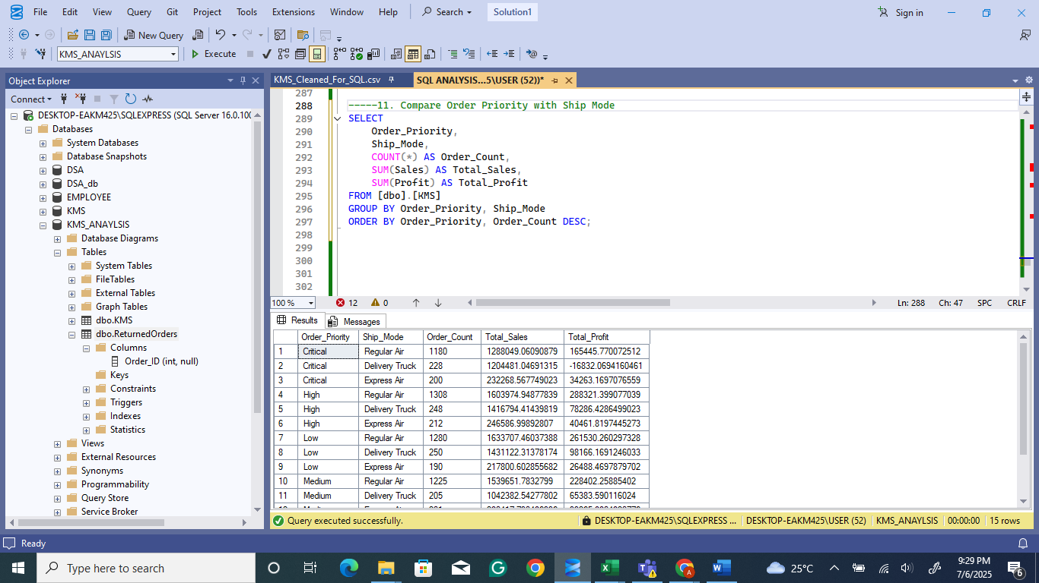
11. COMPARE ORDER PRIORITY WITH SHIP MODE

Slide 14
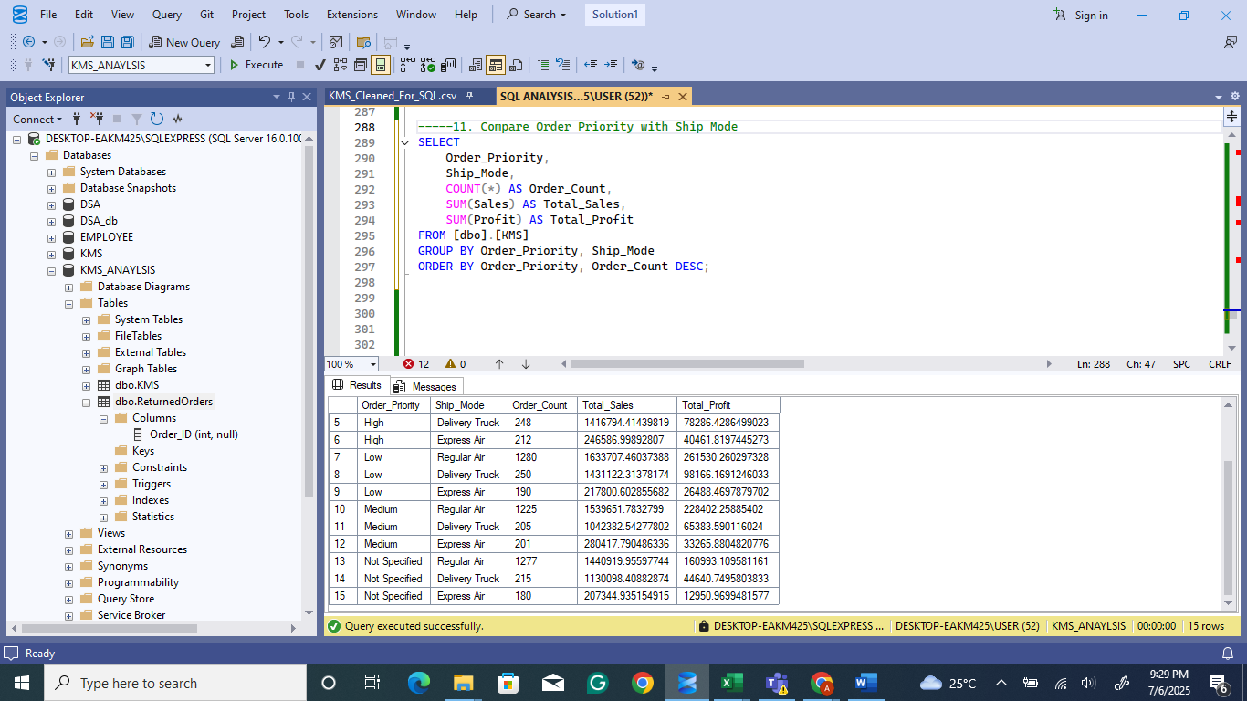
11. COMPARE ORDER PRIORITY WITH SHIP MODE CONT’D

